Slide 1

Fixing a Pallet Magazine Jam
7.16.24 version 1.0

Slide 2
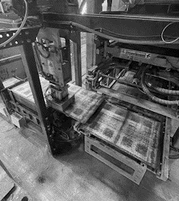
Assumptions and Prerequisite Skills
none
Supplies Needed
Standard PPE

Slide 3
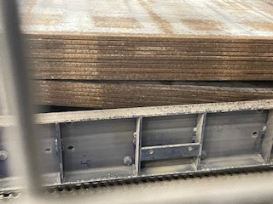
Preface
There are multiple signs to tell when the pallet magazine is jammed. The first indication is when the back of the pallet receiver is missing a pallet and is waiting for another. You can get confirmation by checking the HMI monitor for an error message. The key indicator is examining the pallet magazine and checking to see if there is one side significantly higher than the other (Figure 1). The one side being lower prevents other pallets from the pallet rollover from entering the magazine.
Figure 1

Slide 4
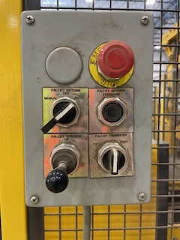
1. Turn the “Pallet Return” switch to the “Manual” position (Blue circle in Figure 2).
Figure 2

Slide 5
2. Move the Pallet Stacker lever (Purple circle in Figure 3) up until all of the “collapsed” pallets are now underneath the rest of the pallets.
Figure 3

Slide 6
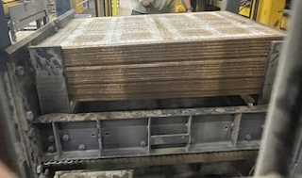
3. Move the “Pallet Stacker” lever down until the pallet stacker platform goes all the way down.
4. This may have resulted in the same collapsed pallets going back down to their original positions. If so, repeat steps 2 and 3 until all pallets stay together at the top when the pallet stacker is at the lowest position. The pallet stack should look similar to Figure 4.
Figure 4

Slide 7
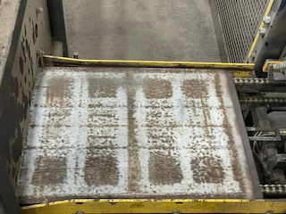
5. Once you think the jam has been fixed, check and see if there is a pallet on the pallet rollover conveyor. If there is, go to step 7. If not, go to step 6.
Figure 5

Slide 8
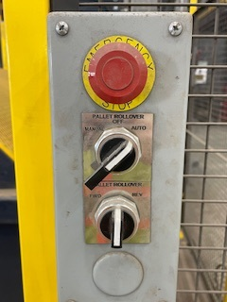
6. Turn the top “Pallet Rollover” switch to the “Manual” position (Purple circle in Figure 6). Turn the bottom “Pallet Rollover” switch to the “Rev” position (Blue circle in Figure 6). Hold it at this position until a pallet has landed on the pallet stacking conveyor. You may need to flip the top over so you can see.
Figure 6

Slide 9
7. Test the magazine by pressing on the “Pallet Return Forward” button (Green circle in Figure 7) and hold it until the pallet is completely underneath the pallet stack.
8. Turn the “Pallet Return” switch back to the “auto” position.
Figure 7

